Slide 1

ICT502
Week 7: Effective Communication Skills in IT Projects
ICT502 Applied IT Project A
1

Slide 2
What we learned last week
Introduction to Project Implementation
Developing an Implementation Plan
Project Execution
Project Monitoring and Controlling
Closing the Project

Slide 3
Why Communication Fails
Common Reasons:
Team members do not respond
Unclear responsibilities
Different expectations
Poor documentation
Technical ideas explained poorly

Slide 4
Communication in Real IT Projects
In Companies Like NSW IT Support:
Teams communicate with:
clients,
managers,
engineers,
vendors,
support staff.

Slide 5
Communication in Real IT Projects
Poor communication can cause:
project delays,
security risks,
client dissatisfaction.

Slide 6
Questions Students Can Ask NSW IT Support
Communication Questions:
How do your teams communicate during projects?
What communication problems happen most often?
How do you manage client expectations?
What tools do you use (Teams, Slack, Jira)?
How do you explain technical issues to non-technical clients?

Slide 7
Communication Plan Example
Stakeholder | Communication Method | Frequency
Client | Email/Meetings | Weekly
Team members | Teams/Slack | Daily
Supervisor | Progress report | Fortnightly

Slide 8
Professional Communication Tips
✔ Be clear ✔ Be concise ✔ Ask professional questions ✔ Listen carefully ✔ Take notes ✔ Confirm understanding

Slide 9
Connecting Week 7 to Assessment 4
Students should include:
communication strategy,
stakeholder management,
reporting methods,
feedback collection methods.
These directly support:
Section 5 (Management)
Section 6 (Communication Plan)

Slide 10
FINAL RECOMMENDATION
Your strongest teaching approach is:
“How would a real IT consultant think?”
Because students usually: X describe technology only
But high-performing students: ✔ identify business problems ✔ justify solutions ✔ explain implementation ✔ communicate professionally ✔ connect technology to business value

Slide 11
Week 7 Pre-Class Readings
YouTube Video:
The Communication 101 for Project Managers
https://www.youtube.com/watch?v=CJr1e2Lp5dI

Slide 12
Week 7 Pre-Class Readings
Key Messages from the Video
The video explains why communication is the most important skill in project management. It also shows useful tools and templates that help teams work better together.

Slide 13
Week 7 Pre-Class Readings
Main Ideas
1. Communication is more important than tools
Project managers may use many methods and tools like Agile, Waterfall, spreadsheets, or Gantt charts, but success mainly depends on how well people communicate and collaborate

Slide 14
Week 7 Pre-Class Readings
2. Projects involve people, and people are complex
Team members can have stress, misunderstandings, or different expectations. Good communication helps build trust, solve problems, and keep everyone informed.

Slide 15
Week 7 Pre-Class Readings
3. Never surprise stakeholders
A project may face delays or problems, but stakeholders should always be informed early. The speaker says:
“You may disappoint stakeholders, but never surprise them.”

Slide 16
Week 7 Pre-Class Readings
4. Communication improves teamwork and productivity
When employees understand goals and receive regular updates, they feel more connected and motivated. Good communication increases productivity and job satisfaction.

Slide 17
Week 7 Pre-Class Readings
5. Planning and communication go together
Successful projects need planning documents such as:
Project charter
Risk management plan
Communication plan
Status reports
These help teams know what to do and how information should be shared.

Slide 18
Week 7 Pre-Class Readings
6. Communication should happen during the whole project
Communication is needed in every project stage:
Starting the project
Planning
Executing work
Monitoring progress
Closing the project

Slide 19
Week 7 Pre-Class Readings
7. Templates and tools help organize information
The video introduces useful tools such as:
Requirements documents
Communication plans
Lessons learned reports
RACI matrices
Risk management charts

Slide 20
Week 7 Pre-Class Readings
8. Learn from mistakes early
Instead of waiting until the end of a project, teams should regularly discuss:
What went well
What went wrong
How to improve
This helps avoid repeating mistakes.

Slide 21
Week 7 Pre-Class Readings
9. Technology supports communication
Tools like Microsoft Teams, Outlook, SharePoint, Trello, and Power BI help teams share updates, files, and reports quickly.

Slide 22
Week 7 Pre-Class Readings
10. Information gives organizations better control
Managers need accurate and timely information to make good decisions. Poor communication causes confusion, delays, and low morale.

Slide 23
Week 7 Pre-Class Readings
Discussion Questions
Question 1
Why is communication important in project management?
Communication helps team members understand goals, solve problems, share updates, and avoid misunderstandings. It also builds trust between the project team and stakeholders.

Slide 24
Week 7 Pre-Class Readings
Question 2
What does the speaker mean by “never surprise stakeholders”?
It means project managers should inform stakeholders early about delays, risks, or problems instead of hiding issues until the last moment.

Slide 25
Week 7 Pre-Class Readings
Question 3
How does communication improve employee motivation?
Employees feel more connected and valued when management shares regular updates and explains company goals clearly.

Slide 26
Week 7 Pre-Class Readings
Question 4
What are some communication tools mentioned in the video?
The video mentions:
Microsoft Teams
Outlook
SharePoint
Trello
Power BI
Status reports
Communication plans

Slide 27
Week 7 Pre-Class Readings
Question 5
What is a communication plan?
A communication plan explains:
Who receives information
What information is shared
How often updates are given
Which communication channels are used

Slide 28
Week 7 Pre-Class Readings
Question 6
Why are lessons learned meetings useful?
They help teams identify mistakes and improvements so future projects can avoid the same problems.

Slide 29
Week 7 Pre-Class Readings
Question 7
What is a RACI matrix used for?
A RACI matrix helps define roles and responsibilities in a project:
Responsible
Accountable
Consulted
Informed

Slide 30
Week 7 Pre-Class Readings
Question 8
Why is planning important before starting work?
Planning helps teams understand goals, risks, schedules, budgets, and responsibilities before execution begins.

Slide 31
Week 7 Pre-Class Readings
Question 9
How does Agile project management use communication?
Agile uses regular discussions and feedback between customers and team members to make changes quickly and improve results.

Slide 32
Week 7 Pre-Class Readings
Question 10
What is the main message of the video?
The main message is that strong communication is the key to successful project management because it improves teamwork, trust, planning, and decision-making.

Slide 33
Week 7 Topics
Why Does Communication Fail in Project Management?
Significance of Communication in Managing Projects
Types of Communication in Project Management
Key Steps to Manage Communication in IT Projects

Slide 34
Pre-Class Discussion
Watch the Video) How to Improve Communication Skills at Work?
Youtube:
https://www.youtube.com/watch?v=knUEdy-kOIQ

Slide 35
Pre-Class Discussion
Key Messages from the Video
1. Miscommunication can damage workplaces
Poor communication can negatively affect teamwork, business strategies, productivity, and relationships at work. Good communication is essential for success.

Slide 36
Pre-Class Discussion
2. Mindfulness improves communication
The speaker explains that being mindful helps people become better communicators. This means paying attention to emotions, body language, and energy during conversations.

Slide 37
Pre-Class Discussion
3. People often understand less than we think
Research from Stanford University showed that presenters often overestimate how much their audience understands. Because of this, important information should be repeated clearly and often.
Main lesson: “Over communicate” important points.

Slide 38
Pre-Class Discussion
4. Clarifying and double-checking prevents misunderstandings
Communication should be a two-way process. People should:
Ask if others understand
Repeat instructions back
Confirm agreements
This helps everyone stay on the same page.

Slide 39
Pre-Class Discussion
5. Taking a pause before responding is important
When emotions are high, people should take a breather before replying.
The speaker suggests:
A 10-second rule for stressful situations
A 24-hour rule for major emotional situations
This helps avoid emotional reactions and improves communication quality.

Slide 40
Pre-Class Discussion
6. Good communication requires active listening
Many people focus on preparing their response instead of truly listening. Effective communicators stay focused on the speaker and listen carefully in the moment.

Slide 41
Pre-Class Discussion
7. Choosing the right communication method matters
Different situations require different communication methods:
Face-to-face for important or sensitive conversations
Email for simple updates
Other methods depending on urgency and purpose

Slide 42
Pre-Class Discussion
8. Communication skills can always improve
The speaker encourages people to continue practicing mindfulness, listening, and clear communication to become stronger communicators at work.

Slide 43
Pre-Class Discussion
Discussion Questions:
Question 1
Why is communication important in the workplace?
Communication is important because it helps teams work together, prevents misunderstandings, improves productivity, and supports better relationships at work.

Slide 44
Pre-Class Discussion
Question 2
What does the speaker mean by “over communicate”?
It means repeating important information clearly and more than once because people may not fully understand the message the first time.

Slide 45
Pre-Class Discussion
Question 3
Why is clarifying information necessary?
Clarifying helps make sure everyone understands instructions, expectations, and agreements correctly. It reduces confusion and mistakes.

Slide 46
Pre-Class Discussion
Question 4
What is the 10-second rule?
The 10-second rule means taking a few deep breaths and counting to 10 before responding in stressful situations to avoid emotional reactions.

Slide 47
Pre-Class Discussion
Question 5
What is the purpose of the 24-hour rule?
The 24-hour rule gives people time to calm down and think carefully before responding to major stressful situations.

Slide 48
Pre-Class Discussion
Question 6
How does active listening improve communication?
Active listening helps people fully understand the speaker instead of focusing only on their own response. This creates better understanding and stronger conversations.

Slide 49
Pre-Class Discussion
Question 7
Why should people choose the right communication method?
Different situations need different communication styles. Important conversations are better face-to-face, while simple updates can be sent by email.

Slide 50
Pre-Class Discussion
Question 8
What role does mindfulness play in communication?
Mindfulness helps people stay calm, focused, aware, and emotionally balanced during conversations.

Slide 51
Pre-Class Discussion
Question 9
What problem happens when people assume others understand everything?
Misunderstandings can happen because listeners may miss details, become distracted, or interpret information differently.

Slide 52
Pre-Class Discussion
Question 10
What is the main message of the video?
The main message is that effective communication requires mindfulness, listening, clarity, patience, and choosing the right communication methods to avoid misunderstandings at work.

Slide 53
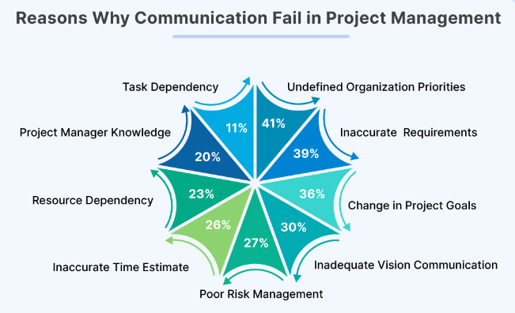
Why Does Communication Fail in Project Management?

Slide 54
Significance of Communication in Managing Projects
Introduction to the Significance of Communication
Definition of Communication:
Formal Definition: Communication is the process of exchanging information, ideas, and feelings between individuals or groups.
Project Context: In IT projects, communication involves the sharing of project-related information among team members, stakeholders, and clients.

Slide 55
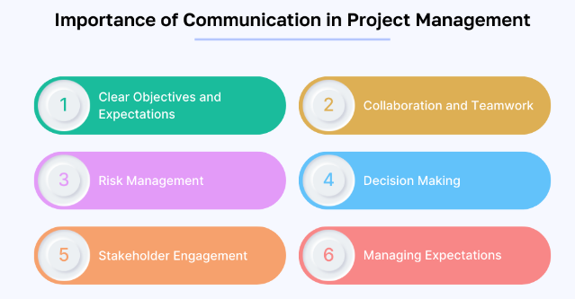
Significance of Communication in Managing Projects (cont.)

Slide 56
Significance of Communication in Managing Projects (cont.)
Overview of Communication in IT Projects:
Project Coordination: Effective communication ensures that all team members are on the same page regarding project goals, timelines, and deliverables.
Stakeholder Engagement: Clear and consistent communication helps in managing stakeholder expectations and keeping them informed about project progress.
Risk Management: Timely communication allows for the early identification and mitigation of risks, preventing potential issues from escalating.

Slide 57
Significance of Communication in Managing Projects (cont.)
Importance of Clear Communication:
Avoiding Misunderstandings: Clear communication reduces the risk of misinterpretations that can lead to errors and rework.
Building Trust: Transparent communication fosters trust among team members and stakeholders, creating a positive project environment.
Enhancing Collaboration: Open lines of communication promote collaboration and teamwork, enabling more effective problem-solving and innovation.

Slide 58
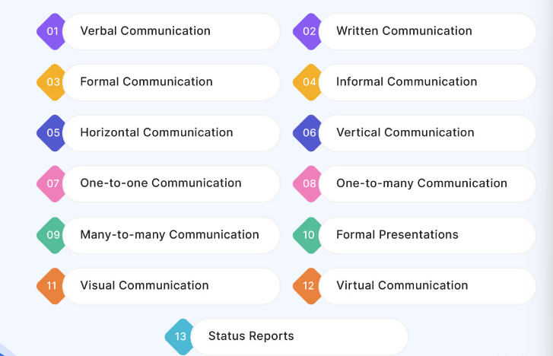
Types of Communication in Project Management

Slide 59
Types of Communication in Project Management (cont.)
Each type of communication serves a specific purpose and is essential for the smooth execution and success of the project.
1. Verbal Communication
Face-to-face conversations, team meetings, conference calls.
Immediate feedback and clarification.
Gauges non-verbal cues.
Resolves conflicts and builds relationships.
2. Written Communication
Emails, memos, reports, project documentation.
Provides detailed information and documents decisions.
Permanent record for reference.
Facilitates asynchronous collaboration.

Slide 60
Types of Communication in Project Management (cont.)
3. Formal Communication
Structured and documented (announcements, progress reports).
Follows specific protocols.
Used in project kickoffs, milestone reviews, contractual discussions.
Ensures professionalism and accountability.
4. Informal Communication
Casual conversations, social interactions.
Builds relationships and shares ideas.
Encourages open dialogue and innovation.
Creates a comfortable team environment.

Slide 61
Types of Communication in Project Management (cont.)
5. Horizontal Communication
Between individuals/departments at the same level.
Coordinates and collaborates among team members.
Ensures mutual support and progress awareness.
Fosters teamwork.
6. Vertical Communication
Information flow up and down the hierarchy.
Managers communicate with team members, who provide updates.
Ensures proper decision-making and information dissemination.
Aligns with organisational goals.

Slide 62
Key Steps to Manage Communication in IT Projects: Establish a Communication Plan
1. Establish a Communication Plan
Purpose:
Define the goals of communication within the project.
Identify the key messages that need to be communicated.
Stakeholder Analysis:
Identify all stakeholders involved in the project.
Determine their communication needs and preferences.
Communication Methods:
Select appropriate communication methods (emails, meetings, reports).
Consider the advantages and limitations of each method.

Slide 63
Establish a Communication Plan (cont.)
Frequency and Schedule:
Set a regular schedule for communication activities.
Ensure timely updates and consistency in information sharing.
Roles and Responsibilities:
Assign specific communication roles to team members.
Clarify who is responsible for creating, distributing, and receiving information.

Slide 64
Key Steps to Manage Communication in IT Projects: Utilise Effective Communication Tools
2. Utilise Effective Communication Tools
Email:
Use for formal communication, detailed instructions, and documentation.
Ensure clear and concise subject lines and content.
Instant Messaging:
Utilise for quick questions, updates, and informal communication.
Choose platforms that support group chats and project-specific channels.
Project Management Software:
Implement tools like Trello, Asana, or Jira for task tracking and updates.
Centralise communication related to specific tasks and milestones.

Slide 65
Utilise Effective Communication Tools(cont.)
Video Conferencing:
Schedule regular virtual meetings for team discussions and updates.
Use platforms like Zoom, Microsoft Teams, or Google Meet for face-to-face interactions.
Document Sharing:
Use cloud-based services like Google Drive or SharePoint for collaborative document management.
Ensure easy access and version control for all team members.

Slide 66
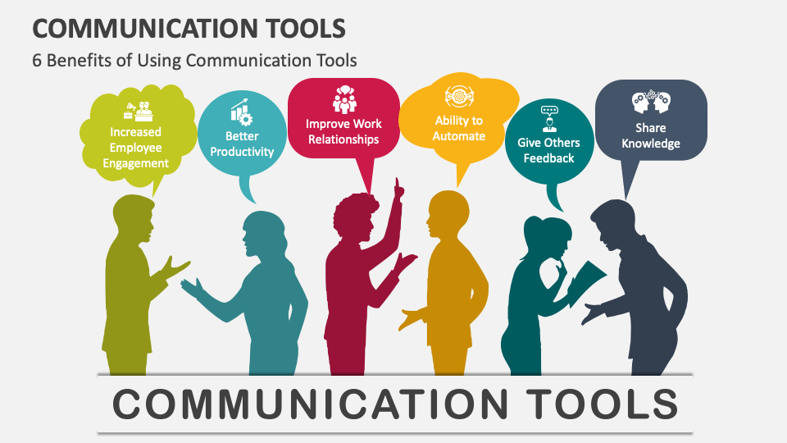
Utilise Effective Communication Tools (cont.)
2. Utilize Effective Communication Tools

Slide 67
Key Steps to Manage Communication in IT Projects: Conduct Regular Meetings
3. Conduct Regular Meetings
Daily Stand-ups:
Hold brief daily meetings to review progress, identify blockers, and plan tasks.
Ensure everyone is aware of their responsibilities for the day.
Weekly Progress Meetings:
Discuss overall project status, milestones, and upcoming tasks.
Address any issues or risks that may impact the project.
Stakeholder Meetings:
Regularly update stakeholders on project progress and gather feedback.
Use these meetings to align stakeholder expectations with project outcomes.
Ad-hoc Meetings:
Schedule as needed to address urgent issues or changes in the project.
Ensure key team members are available for these meetings.

Slide 68
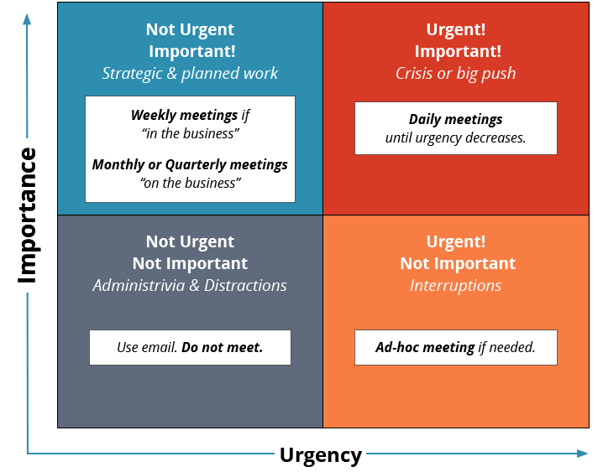
Conduct Regular Meetings

Slide 69
Key Steps to Manage Communication in IT Projects: Foster Open and Transparent Communication
4. Foster Open and Transparent Communication
Encourage Feedback:
Create an environment where team members feel comfortable providing feedback.
Actively listen to concerns and suggestions from all team members.
Transparent Reporting:
Share project status, challenges, and successes openly with the team.
Use dashboards and regular updates to keep everyone informed.
Two-way Communication:
Promote dialogue rather than one-way communication.
Ensure team members can ask questions and share their thoughts freely.
Conflict Resolution:
Address conflicts quickly and fairly.
Use mediation techniques to find mutually acceptable solutions.

Slide 70
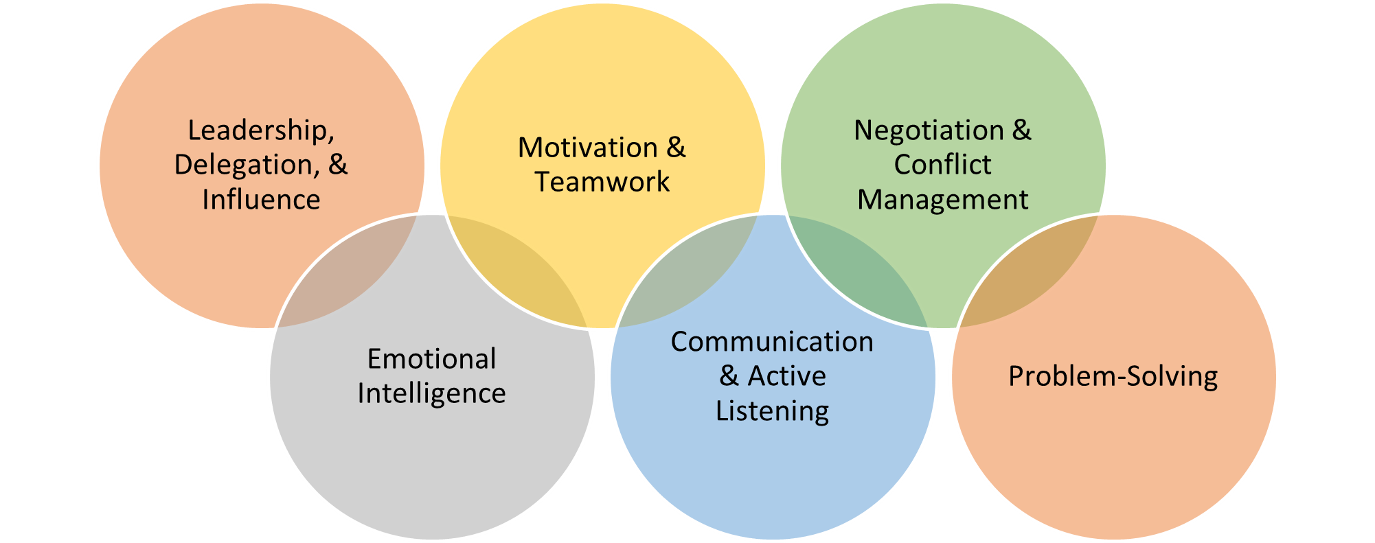
Foster Open and Transparent Communication: Conflict Resolution

Slide 71
Key Steps to Manage Communication in IT Projects: Monitor and Evaluate Communication Effectiveness
5. Monitor and Evaluate Communication Effectiveness
Feedback Collection:
Regularly gather feedback on communication processes from team members.
Use surveys, interviews, or informal discussions to collect insights.
Performance Metrics:
Track key metrics such as response times, meeting attendance, and task completion rates.
Use these metrics to assess the effectiveness of communication strategies.
Continuous Improvement:
Analyse feedback and performance data to identify areas for improvement.
Adapt and refine communication strategies based on lessons learned.
Training and Development:
Provide ongoing training for team members on effective communication techniques.
Encourage the development of soft skills such as active listening and clear articulation.

Slide 72
Group Discussion Case Study
Scenario: A kickoff meeting for a new IT project
You are a project manager tasked with leading a kickoff meeting for a new IT project. The project involves developing a mobile application for a client in the healthcare sector. The meeting will include key stakeholders from both your project team and the client's organisation.
Questions:
What are the primary objectives of this project?
Who are the stakeholders involved in this project?
What are the initial milestones we need to achieve?
How will communication be managed between our team and the client?

Slide 73
Case Study: Discussion Points
Primary Objectives of the Project:
Develop a mobile application tailored for the healthcare sector to improve patient engagement, access to healthcare services, and operational efficiency for healthcare providers.
Stakeholders Involved in the Project:
Project Team:
Developers, designers, testers, project manager.
Client's Organisation:
IT manager, healthcare providers (doctors, nurses), patient representatives.
Initial Milestones to Achieve:
Complete requirements gathering and analysis phase.
Develop and approve the initial UI/UX design mockups.
Build a functional prototype for internal testing.

Slide 74
Case Study: Discussion Points
Communication Management Plan:
Regular project status meetings:
Weekly video conferences with key stakeholders.
Bi-weekly progress reports via email.
Use of a centralised project management tool (e.g., Jira) for issue tracking and collaboration.

Slide 75
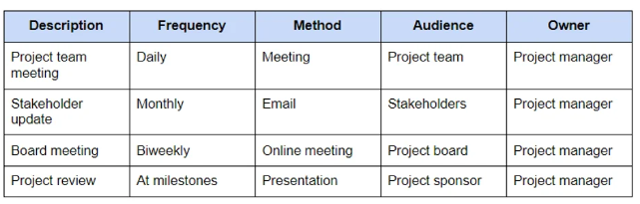
Case Study: Discussion Points
Here is a basic example of a project management communication plan:

Slide 76
Summary
Communication plays a crucial role in project management by ensuring clarity of goals, coordinating efforts among team members, and managing stakeholder expectations effectively.
In project management, communication is integral throughout the project lifecycle—from initiating and planning phases to execution, monitoring, and closing stages.
Types of Communication in Project Management include Verbal Communication, Written Communication, Formal Communication, and Informal Communication.
Key Steps to Manage Communication in IT Projects: Establish a Communication Plan, Utilise Effective Communication Tools, Conduct Regular Meetings, Foster Open and Transparent Communication, Monitor and Evaluate Communication Effectiveness.

Slide 77
Q&A
Question?

Slide 78
Week 7 Workshop :
Effective Communication Skills in IT Projects
ICT502
ICT502 Applied IT Project A
78

Slide 79

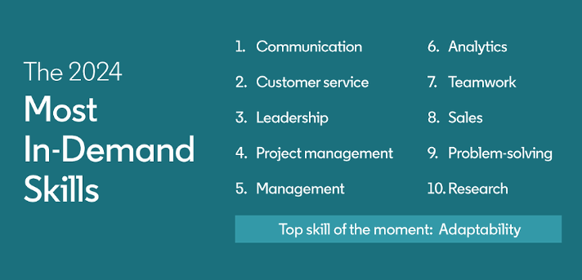
The Most In-Demand Skill: Communication

Slide 80
Why Projects Fail Due to Communication Issues?
#1: Lack of Clarity and Misalignment
Miscommunication of Objectives
Impact: When project goals and objectives are not clearly communicated to all stakeholders, team members may work towards different outcomes.
Consequence: Leads to misalignment of efforts, wasted resources, and delays in project delivery.
Poor Stakeholder Engagement
Impact: Inadequate engagement with stakeholders results in insufficient input and feedback throughout the project lifecycle.
Consequence: Increases the likelihood of delivering a product that does not meet user needs or expectations.
Ambiguous Roles and Responsibilities
Impact: Unclear roles and responsibilities among team members lead to overlaps, gaps, and misunderstandings in project execution.
Consequence: Delays in decision-making, lack of accountability, and increased risk of project scope creep.

Slide 81
Why Projects Fail Due to Communication Issues? (cont.)
#2: Ineffective Communication Channels
Overreliance on Email Communication
Impact: Important details may get lost in lengthy email threads or overlooked due to email overload.
Consequence: Miscommunication of critical information, delayed responses, and unresolved issues.
Inadequate Use of Project Management Tools
Impact: Insufficient utilisation of project management tools for tracking tasks, milestones, and issues.
Consequence: Difficulty in monitoring project progress, identifying risks, and coordinating team efforts.
Lack of Face-to-Face Communication
Impact: Relying solely on virtual communication may hinder rapport building and understanding of non-verbal cues.
Consequence: Reduced team cohesion, misunderstandings, and decreased morale.

Slide 82
Why Projects Fail Due to Communication Issues? (cont.)
#3: Ineffective Communication Breakdowns and Conflict
Communication Silos
Impact: Lack of cross-functional communication leads to isolated teams or departments working in isolation.
Consequence: Duplication of efforts, missed opportunities for collaboration, and delays in decision-making.
Conflict Mismanagement
Impact: Ignoring or mishandling conflicts among team members or stakeholders disrupts project progress and team dynamics.
Consequence: Decreased productivity, morale, and potential project abandonment.
Poor Crisis Communication
Impact: Inadequate preparation and response during crises or unexpected events result in panic and confusion among stakeholders.
Consequence: Increased project risks, damaged reputation, and loss of stakeholder trust.

Slide 83
Video: Project Communications Management Overview
Project Communications Management
Watch this video to learn :
https://www.youtube.com/watch?v=S2lLKYV4e6M

Slide 84
Workshop Activity 1
Scenario 1: Requirements Miscommunication
Scenario: During the initial phase of developing a new CRM system for a client, the requirement's gathering session was conducted with key stakeholders from the client's sales and marketing teams. However, due to miscommunication and differing interpretations, the development team received conflicting information about the core functionalities needed.
Discuss in your groups:
What were the primary challenges encountered during the requirements gathering session?
How did the miscommunication impact the project timeline and budget?
What steps could have been taken to prevent or minimise requirements miscommunication?

Slide 85
Workshop Activity 2
Scenario 2: Cross-Functional Team Communication Breakdown
Scenario: In a software development project involving multiple teams (development, QA, and operations), there was a breakdown in communication regarding a critical software update deployment timeline. The development team completed the update earlier than expected, but due to inadequate communication with the operations team, the deployment was delayed.
Discuss in your groups:
What were the contributing factors to the breakdown in communication between the development and operations teams?
How did the delayed deployment impact project delivery and stakeholder satisfaction?
What strategies could be implemented to improve cross-functional communication in future projects?

Slide 86
Workshop Activity 3: Open Questions
Discuss in your group with the help of an online search platform:
How do you ensure effective communication among diverse team members with varying technical backgrounds in an IT project?
What role does active listening play in resolving conflicts or misunderstandings during IT project execution?
Can you share a scenario where poor communication negatively impacted an IT project? How was it resolved, and what lessons were learned?
What communication challenges do you anticipate when working with remote or distributed teams in IT projects? How would you address these challenges?
How do you prioritise transparency and clarity in communicating project updates and milestones to stakeholders in IT projects?

Slide 87
Workshop Activity 4: Infographic summary
◆ Students are required to list the concepts that have been covered in the reading materials and lecture and group them by their category.
◆ Use an online tool (such as https://www.canva.com/ ) to produce the infographic summary to be submitted and present to the class.

